Slide 1
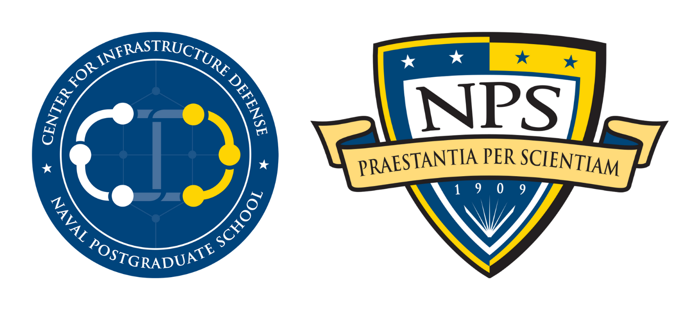
Rethinking Research for Critical Infrastructure
David Alderson, PhD
Professor, Operations Research Department
Executive Director, Center for Infrastructure Defense
Naval Postgraduate School, Monterey, CA
Visiting Scientist, Adaptive Capacity Labs
April 2024
The views expressed here represent the perspective of the authors only and do not necessarily reflect the policy of the Navy or Department of Defense.

Slide 2
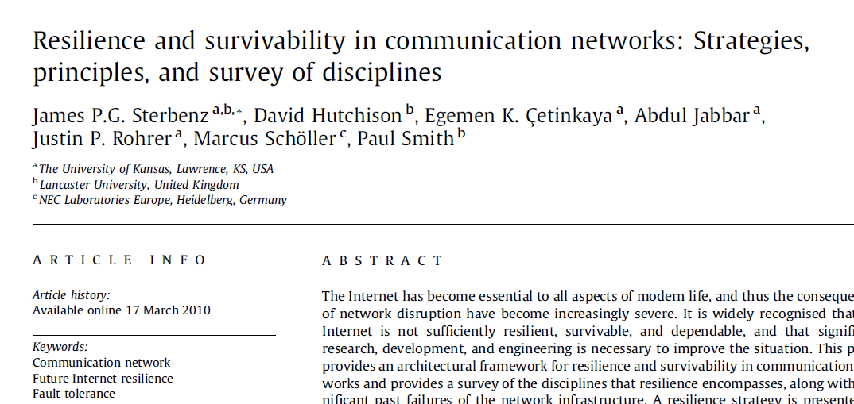
Act I:
The US Infrastructure Resilience Renaissance
1997
2001 – 2005
2009 – 2010
2012 – 2013
Drivers
Theories
Frameworks
Policies
Notes:
Over 15 years of infrastructure resilience work across many influential organizations. From finding the initial drivers of cascading and sudden infrastructure failures, to theories about these phenomena, to frameworks to study and measure them, to plans / directives to implement them in real systems. We got it all figured out.

Slide 3
Act I:
The US Infrastructure Resilience Renaissance
Act II:
1997
2001 – 2005
2009 – 2010
2012 – 2013
2013 – 2023
Drivers
Theories
Frameworks
Policies
Modeling
+
Simulation
Conferences
Journals
National Funding
Centers of Excellence
Universities
National Laboratories
FFRDCs
Defense Contractors
Notes:
Over 15 years of infrastructure resilience work across many influential organizations. From finding the initial drivers of cascading and sudden infrastructure failures, to theories about these phenomena, to frameworks to study and measure them, to plans / directives to implement them in real systems. We got it all figured out.

Slide 4
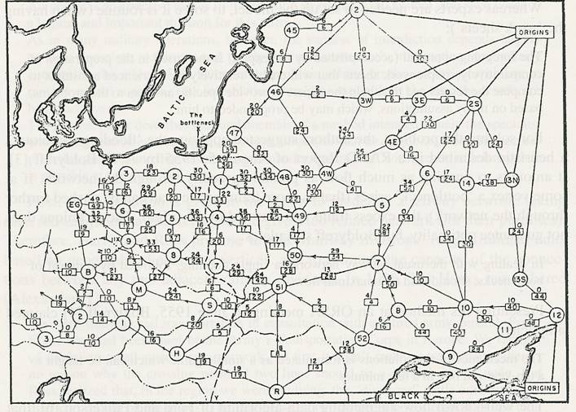
The Premise
Russian Rail Network circa 1955
We can map out our infrastructure systems
And their dependencies
And model their operation
To identify vulnerabilities
Then fill holes and/or block cascading consequences
And doing all this will allow us to fix things going forward…

Slide 5
The Premise
Russian Rail Network circa 1955
We can map out our infrastructure systems
And their dependencies
And model their operation
To identify vulnerabilities
Then fill holes and/or block cascading consequences
And doing all this will allow us to fix things going forward…
Alderson, D., Brown, G., Carlyle, M., and Cox, L. A., 2013, "Sometimes There is No "Most-Vital" Arc: Assessing and Improving the Operational Resilience of Systems," Military Operations Research, 18(1), pp. 21-37.

Slide 6
The Premise
Attacker - Defender Models
B.
1
2
3
4
We can map out our infrastructure systems
And their dependencies
And model their operation
To identify vulnerabilities
Then fill holes and/or block cascading consequences
And doing all this will allow us to fix things going forward…
1
5
6
7
1
8
1
2
2
9
10
11
12
2
1
1
13
14
15
16
1
Alderson, D.L., Brown, G., and Carlyle, W.M., 2015, "Operational Models of Infrastructure Resilience," Risk Analysis 35(4): 562-586

Slide 7
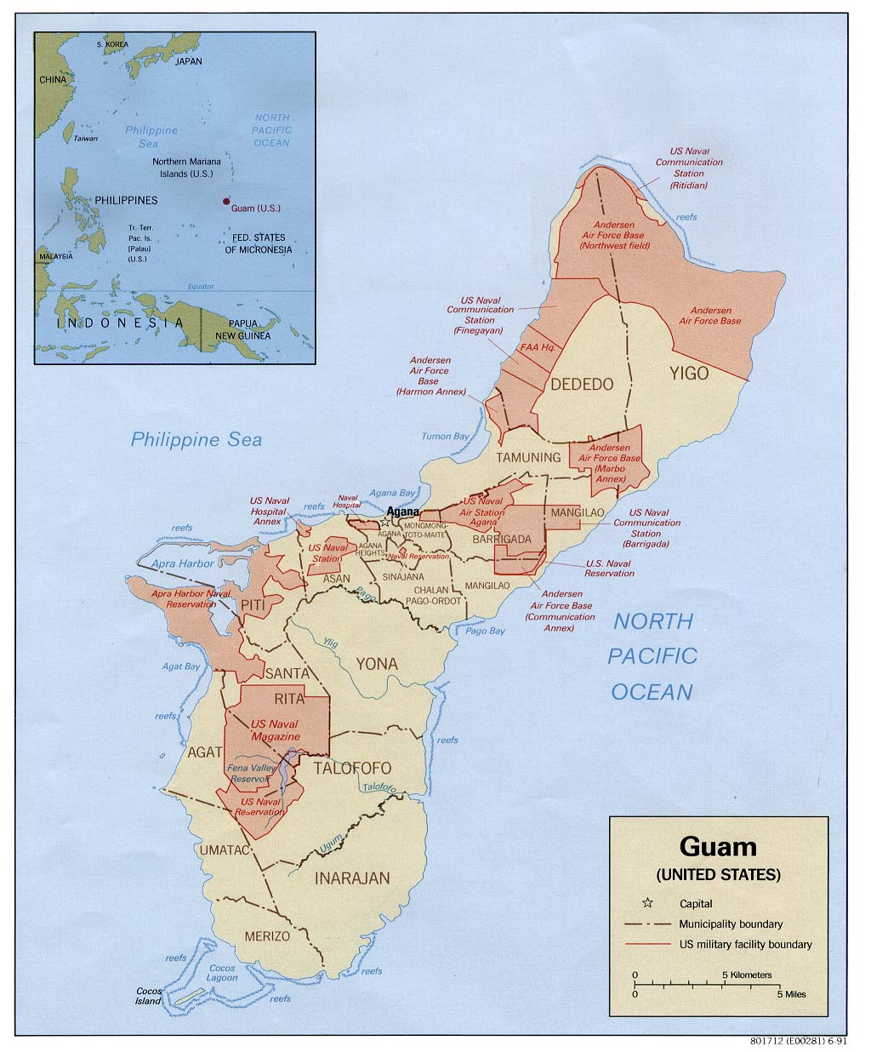
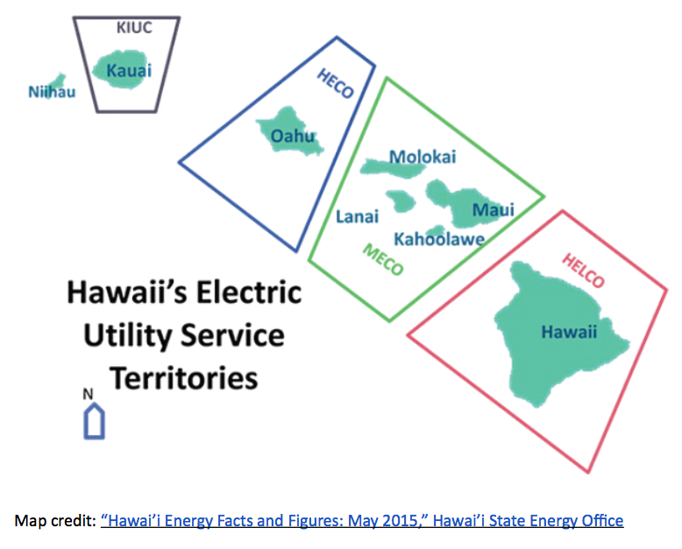
Energy Security: Guam Power Authority
Energy Security: Hawaii
Attacker, Defender, & Spare Parts Analysis
Guam Power Authority’s
transmission system
Can a small number of coordinated attacks inflict significant damage for which repair would require considerable reconstitution time?
What is the best means of hardening against such attacks?
Both Attacker and Defender Analysis
Reference: Salmerón, J., Alderson, D., Brown, G., and Wood, R.K., 2012, Resilience Report: The Guam Power Authority Electric Power Grid: Analyzing Vulnerability to Physical Attack (U), Center for Infrastructure Defense Technical Report NPS-OR-12-002, May. Distribution authorized to DoD and DoD Contractors only due to infrastructure vulnerability analysis (10 May 2012). Other requests for this document must be referred to President, Code 261, Naval Postgraduate School, Monterey, CA 93943-5000 via the Defense Technical Information Center, 8725 John J. Kingman Rd., STE 0944, Ft. Belvoir, VA 22060-6218.
Prepared for: Air Force Research Lab (AFRL), Airbase Technologies Division, 139 Barnes Drive, Suite 2, Tyndal Air Force Base, FL 32403-5323.
How can a limited stockpile of medium- and high-voltage spare transformers contribute most to mitigating vulnerability, i.e., to “increasing system resilience”?
Reference: Salmerón, J., Alderson, D., and Brown, G., 2018, Resilience Report: Analysis of Hawaiian Electric Power Grid to Physical Attack (U), NPS Technical Report NPS-OR-18-001R, February. Restricted distribution (PCII).
Prepared for: Department of Homeland Security, Infrastructure Protection Division.

Slide 8
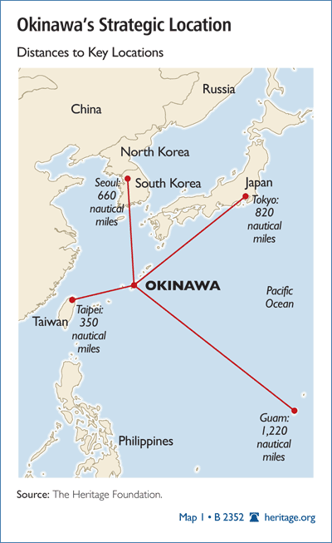
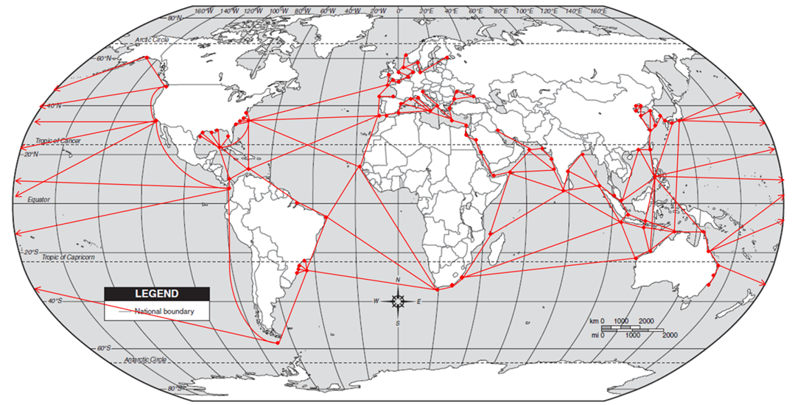
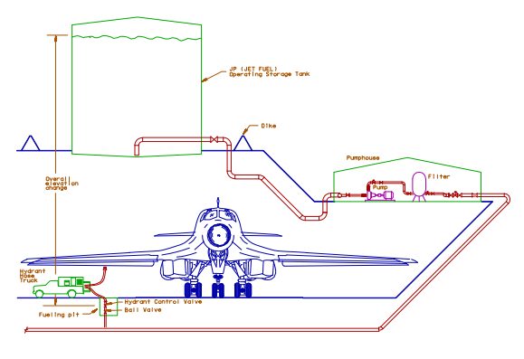
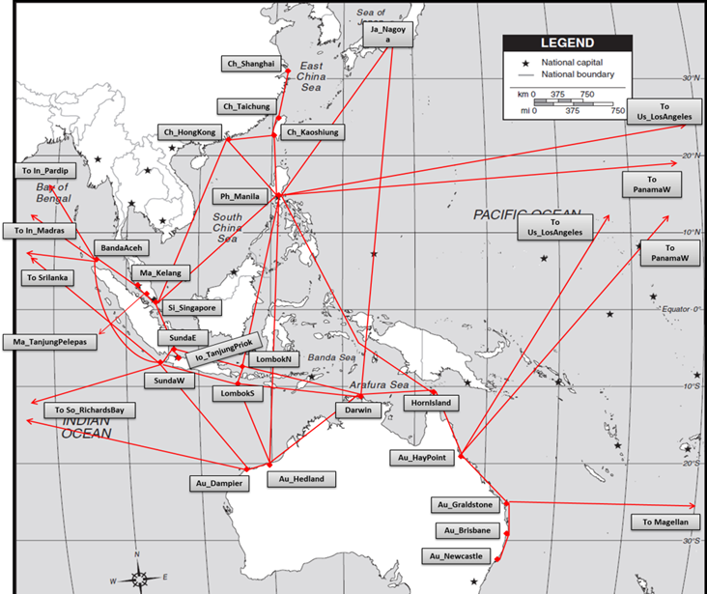
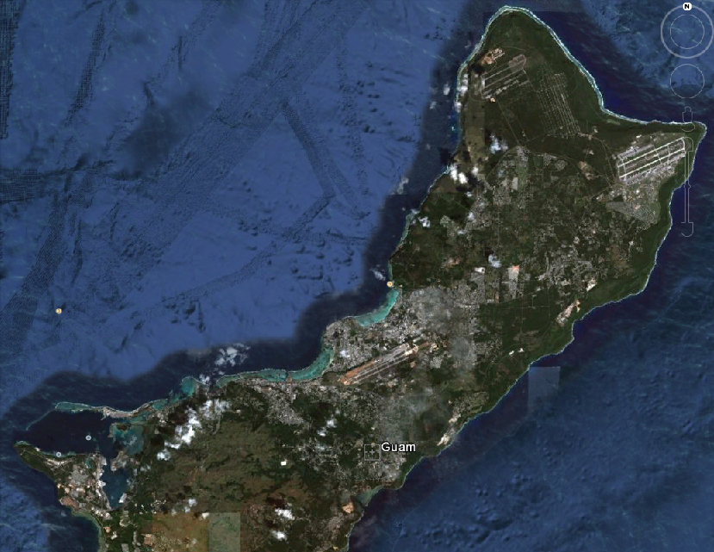
A Simplified View of Military Fuel Supply Chain, 1999-2019
Crude Transport
Bulk Refined Transport
Distribution
Focus: DFM, JP5, JP8 (JetA)
Source
Tanker
Refinery
Intermediate Terminal
(DFSP)
Tanker, Barge
Base Terminal
(DFSP)
Tanker
Pipeline
Pipeline
Rail
Truck
Aircraft
Ships
Aircraft
Ships
AAFB
Apra
Harbor
Tiyan
Station
Sasa
Valley
Guam

Slide 9
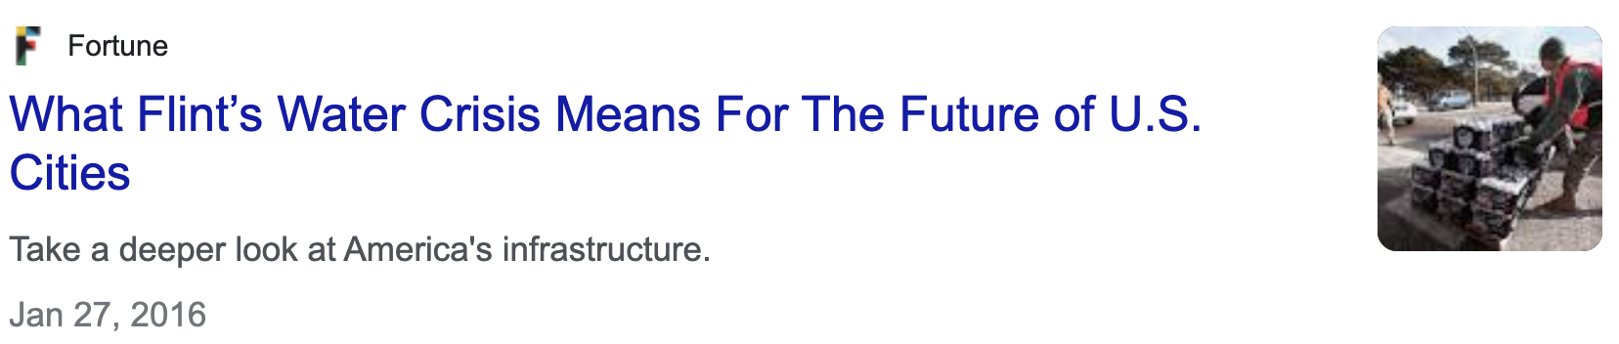

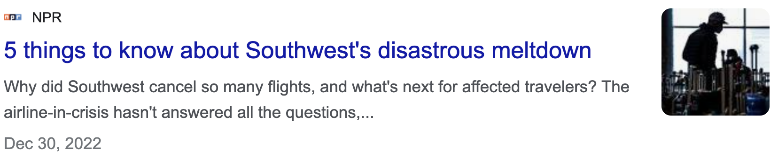
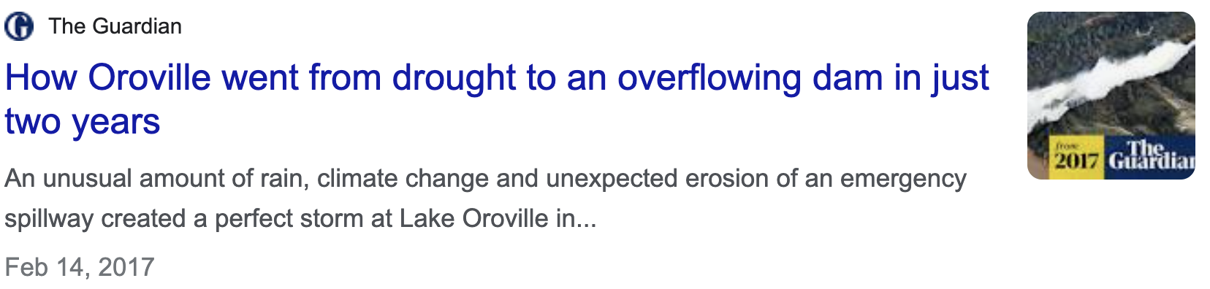
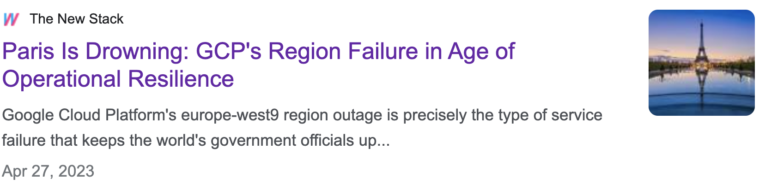
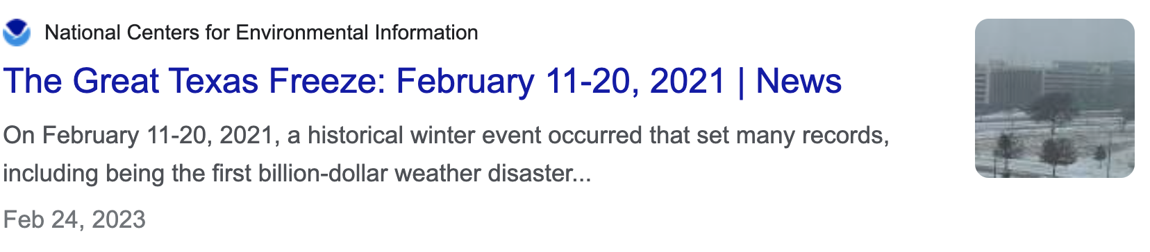
But Wait… An All-Too Common Pattern…
According to Plan, things appear to be going great.
Getting better and better, or so it seems!
Until it isn’t. And then it’s bad…
And unclear how to respond.

Slide 10
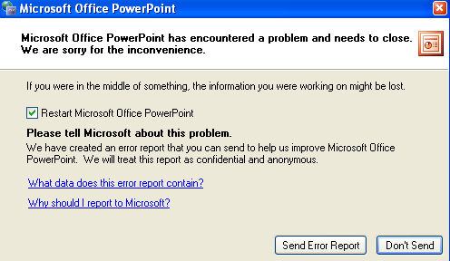
But Wait… An All-Too Common Pattern…
When things fail… they often do so cryptically and catastrophically.
According to Plan, things appear to be going great.
Getting better and better, or so it seems!
Until it isn’t. And then it’s bad…
And unclear how to respond.

Slide 11
The Premise…
…This Is Not Working!!
We can map out our infrastructure systems
And their dependencies
And model their operation
To identify vulnerabilities
Then fill holes and/or block cascading consequences
And doing all this will allow us to fix things going forward…
We don’t know our systems in their absolute entirety, and we never will!
There is no single vantage point from where we can “see” everything
And things are always changing
There will always be hidden dependencies
There will always be surprises!

Slide 12
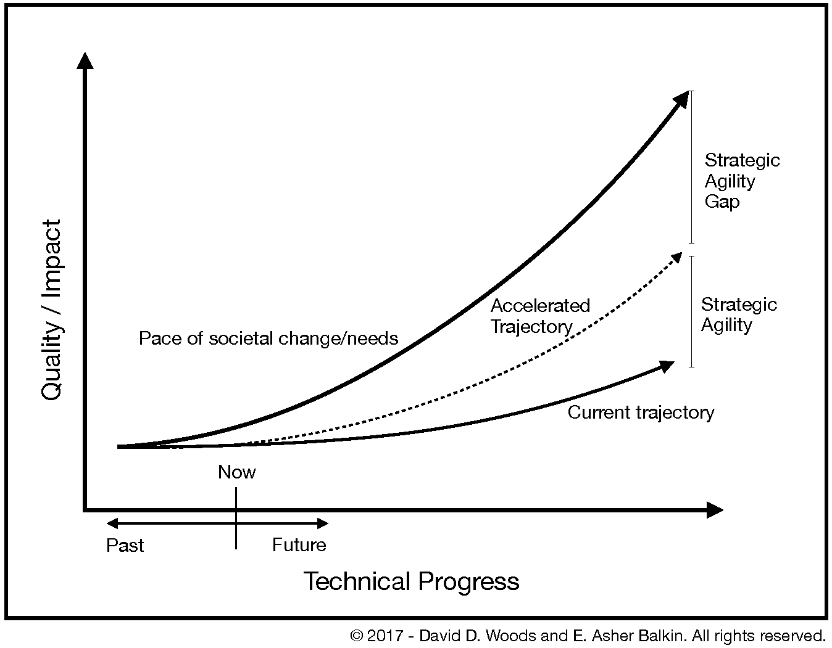
In reality, we face a variety of growing hazards
Growing system complexity
New threats
Changing environment
We face a Strategic Agility Gap in our ability to respond to new threats
Can we learn how to offset changing risks before failures occur as growth continues?
Can we build capabilities to be poised to adapt to keep pace with and stay ahead of the trajectory of growing complexity and the penalties that arise as a result?
References:
Woods D.D., Alderson D.L. (2022). "Progress Toward Resilient Infrastructures: Are we falling behind the pace of events and changing threats?," Journal of Critical Infrastructure Policy, 2(2):5-18. doi: 10.18278/jcip.2.2.2
Woods, D.D. (2020). “The Strategic Agility Gap: How Organizations are Slow and Stale to Adapt in a Turbulent World.” In Journé, B., Laroche, H., Bieder, C. and Gilbert, C. (Eds.), Human and Organizational Factors: Practices and Strategies for a Changing World. Springer Open & the Foundation for Industrial Safety Culture, Springer Briefs in Safety Management, Toulouse France, pp. 95-104 https://doi.org/10.1007/978-3-030-25639-5

Slide 13
Another Way Forward
We need to study these patterns of complexity as empirical phenomena
Need to understand these patterns
Without getting caught up in all the ”noise”
Otherwise you will get lost
Where we agree…
Where it’s noisy…
Oversimple abstractions don’t work (at least, not for long)
Linear systems with predictable cause-effect
Root-cause analysis (e.g., blame the human!)
Stationarity in time
What are the patterns?
What drives them?
What to do about them?

Slide 14
A Provocation
You NEVER have complete knowledge of the system
The system and its dependencies are ALWAYS evolving
Better planning and forecasting will not get around this
New technologies (e.g., AI/ML) will not get around this
You WILL be surprised
Business-as-usual in infrastructure research WILL make a good career…
…But it WILL NOT change anything
We need to find a better way. We need an ACT III. What will you do?

Slide 15
Looking Forward
We need a different type of architecture for our mission critical systems.
One that goes beyond traditional optimization and design.
The principles are different, but ubiquitous in the real world.
We cannot escape the complexity traps if we don’t build adaptive capacity.
We need to reframe how we think about resilience.
Adaptive capacity is about more than handling challenge.
It is about seizing opportunity.
The same processes are at work. We should stop using an emergency management / risk mindset.
23

Slide 16

Contact Information
Dr. David Alderson
Executive Director, Center for Infrastructure Defense
Naval Postgraduate School
dlalders@nps.edu
http://faculty.nps.edu/dlalders
NPS Center for Infrastructure Defense
http://www.nps.edu/cid

